Slide 1
Mega Cap
Case 1 - NVIDIA

Slide 2
OPTION 1
"I am preparing for tomorrow's mega-cap earnings releases for [Insert Tickers, e.g., AAPL, MSFT, NVDA].
Please analyze the setup and address the following:
Macro & Geopolitical Factors: Has there been any recent geopolitical news or strategic moves by global competitors since their last reports that could positively or adversely impact these tickers?
Aggregate Index Impact: What is the expected net impact on S&P 500 (ES) and Nasdaq 100 (NQ) futures?
Directional Bias & Volatility: What is your anticipated direction (bullish or bearish), and do you expect major price expansion up or down?
Price Gap Potential: Is the market reaction likely to create a price gap at the open/session restart?
Move Severity Score: Grade the potential scale of the price move from 0 to 5 (0 = negligible/sideways movement, 5 = massive volatility/extreme range expansion).
Keep the analysis direct, structured, and focused on trading implications."

Slide 3
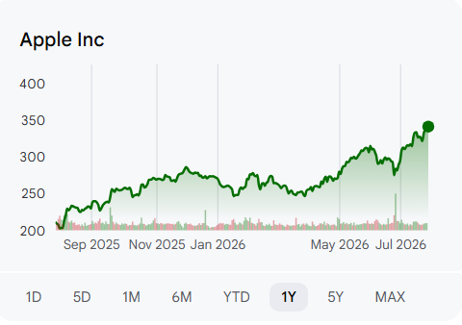
Google Finance
Based on the provided earnings calendar screenshots, the only mega-cap stock scheduled to report earnings tomorrow (July 30, 2026) is Apple Inc. (NASDAQ:AAPL), which is listed to release its results after the market close.

Slide 4
Google Finance
Geopolitical & Macroeconomic Factors
The primary geopolitical and macro elements impacting market sentiment ahead of Apple Inc.'s (NASDAQ:AAPL) earnings report include:
U.S.–Iran Conflict Developments: Crude oil prices recently pulled back to around $89–$96 per barrel following the sudden suspension of U.S. airstrikes against Iran. This pause in hostilities has relieved broad inflationary pressures and provided a positive backdrop for consumer discretionary sentiment.
Supply Chain and Tariffs: Ongoing "China Plus One" supply diversification shifts to India and Vietnam continue to influence Apple's structural costs. Potential shifts in U.S. tariff policy and strict EU antitrust regulations targeting the App Store remain active long-term compliance headwinds.
Nasdaq (INDEXNASDAQ:. IXIC): Bullish Stabilizer. The Nasdaq-100 recently narrowly avoided entering official correction territory due to a steep chip sector selloff.

Slide 5
Google Finance
Anticipated Bias: Modestly Bullish. Apple has outperformed its peer group year-to-date and briefly touched a historic $5 trillion market valuation intraday. Call option open interest heavily outpaces put options at key near-the-money thresholds, showcasing solid retail and institutional confidence.
Price Expansion & Gapping: Volatility expansion is expected. The options market is currently pricing in an implied one-day move of approximately 3.6% to 4.0%. This is significantly higher than Apple's historical 1-day average earnings move of roughly 1% over the past year, creating strong structural potential for an opening price gap on Friday morning. However, surging components/memory costs (NAND and DRAM) capping gross margins could limit a runaway upside breakout.
Grade: 3.5 / 5 While Apple typically tracks as a stable giant, the massive options implied volatility premium, the symbolic context of its $5 trillion valuation hurdle, and its role as the final earnings report under CEO Tim Cook before the September leadership transition raise the stakes for an uncharacteristically sharp, volatile reaction.

Slide 6
Gemini
there is only one mega-cap ticker among them reporting tomorrow after market close: Apple Inc. (NASDAQ: AAPL).
Geopolitical Factors Impacting the Move
Taiwan & Supply Chain Risks: Apple remains heavily reliant on TSMC (Taiwan) for its custom silicon chips (A-series and M-series). Any ongoing trade friction or regional volatility directly impacts forward margin guidance and risk sentiment.
China Demand & Regulatory Headwinds: Greater China represents a major portion of iPhone revenue. Investors will scrutinize sales figures for signs of domestic market share shifts and regulatory pressures surrounding AI and foreign tech compliance in the region.
Global Tariff & Trade Policies: Global macro policies and tech-export restrictions affect international component pricing and global consumer purchasing power.

Slide 7
Gemini
Expected Net Impact on S&P 500 & Nasdaq
Outsized Market Index Weight: As a multi-trillion-dollar market cap titan, AAPL carries significant weight in both the S&P 500 (~7%) and Nasdaq 100 (~8-9%).
Broader Market Sentiment: A surprise beat or miss by Apple will heavily dictate Friday's market direction, likely pulling down or lifting broader tech and consumer discretionary sectors regardless of earnings from mid-cap names.
Directional Bias (Bullish vs. Bearish) & Price Expansion
Bias: Slightly Bullish to Neutral. Wall Street is anticipating solid Q3 results driven by Services margin stability and steady iPhone upgrades. However, high expectations mean guidance on memory costs and AI features needs to overdeliver to sustain the rally.
Price Expansion: Expected. Options markets are currently pricing in a typical post-earnings move of around ±3.5%.

Slide 8
Gemini
Potential for a Price Gap
High Risk of an Overnight Gap. Because Apple reports after the market closes on July 30, the reaction will take place in after-hours trading.
Expect the Friday morning open to feature a notable gap up or gap down depending on management's forward Q4 guidance and commentary on consumer hardware adoption.
Potential Price Move Grade: 4 / 5
Grade Explanation: While Apple’s standalone implied volatility move (±3.5%) is smaller in percentage terms compared to high-beta stocks like MicroStrategy (MSTR) or First Solar (FSLR), its dollar-value impact on the macro market is massive. A 3–4% swing on AAPL equates to over $100+ billion in market cap shifting overnight, making it a high-impact catalyst for the entire market.

Slide 9
Option 2
"Analyzing tomorrow's mega-cap earnings for [Insert Tickers]:
Considering these reports along with any recent geopolitical news or competitor developments:
What is the aggregate impact on S&P 500 and Nasdaq futures?
Which direction do you anticipate price moving, and is a major price expansion expected?
Is this response expected to create an opening price gap?
Grade the potential price movement on a scale of 0 to 5 (0 = lowest movement, 5 = biggest projected movement).
Provide a brief summary with key market levels."

Slide 10
Option 3
Why this wording works:
"Macro & Geopolitical Headwinds/Tailwinds" frames the competitor and global news question using standard market terminology, signaling the AI to look at trade policies, regional demand, supply chain disruptions, or foreign competitive threats.
Streamlined flow: Placing the macro news check first builds the fundamental backdrop before jumping into index impact, directional bias, and gap risk.

Slide 11
What the AI's Output Will Look Like:
Adding this metric will force the AI to give you a clear, quantified rating alongside its breakdown, such as:
Price Move Severity Score: 4/5
Rationale: High market weight + high implied volatility in options pricing suggests a significant move relative to h

Slide 12
Any Mega-Cap Competitor Global Events
Future Events:
Global IPO Launch
Global Quarterly Earnings Report
Global Announcements
What is the aggregate Impact to S&P500 & NasDaq Futures
Do you expect a major Increase or Decrease if Price action
Which Direction Do you anticipate the movement
Will the response create a Price Gap

Slide 13
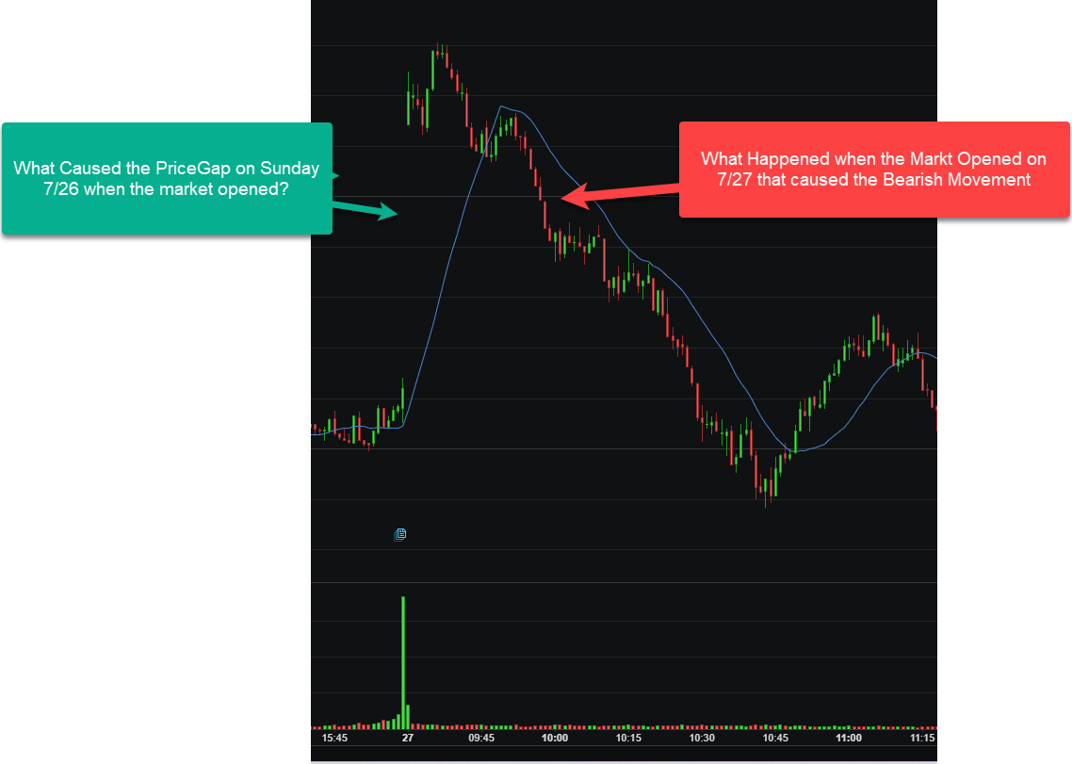

Slide 14
Based on financial market events from Sunday, July 26, and Monday, July 27, 2026:
The Price Gap on Sunday, July 26 (Market Open): The upward gap at the Sunday futures open was driven by significant geopolitical relief. Over the weekend, the United States and Iran paused military strikes, which drastically eased fears of an escalating Middle East conflict and a prolonged Red Sea blockade. As a result, crude oil prices tumbled by roughly 6% to 7%, sparking a sharp risk-on rally that caused stock indices to gap higher overnight.
The Bearish Movement on Monday, July 27 (Market Open): The reversal into a sharp downward trend after the opening bell was triggered by renewed pressure on the technology sector, specifically semiconductor stocks. A major catalyst was the blockbuster debut of Chinese memory chipmaker CXMT on the Shanghai Stock Exchange, coupled with reports that China had successfully begun developing its own deep ultraviolet (DUV) lithography machines. This raised immediate concerns over intensified global competition and future market share, causing the VanEck Semiconductor ETF (SMH) to drop over 4% and dragging down major tech indexes despite the broader geopolitical relief.

Slide 15
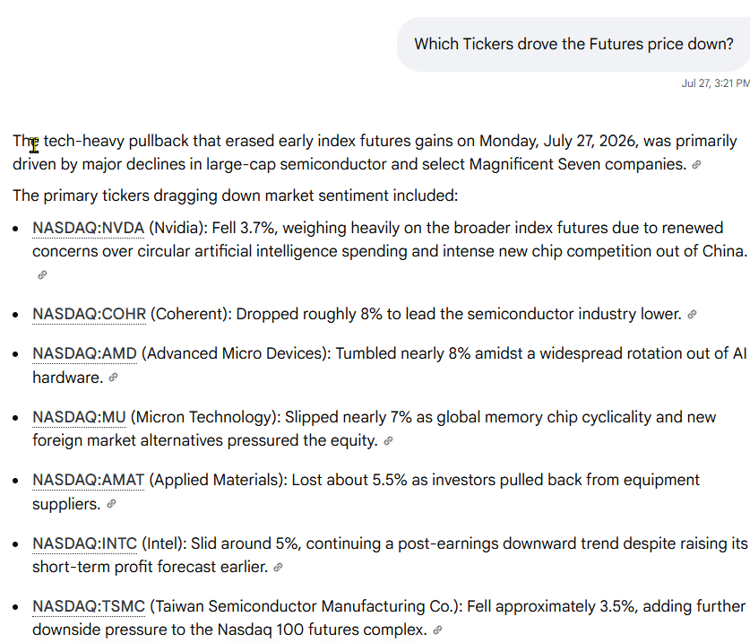

Slide 16
